Slide 2
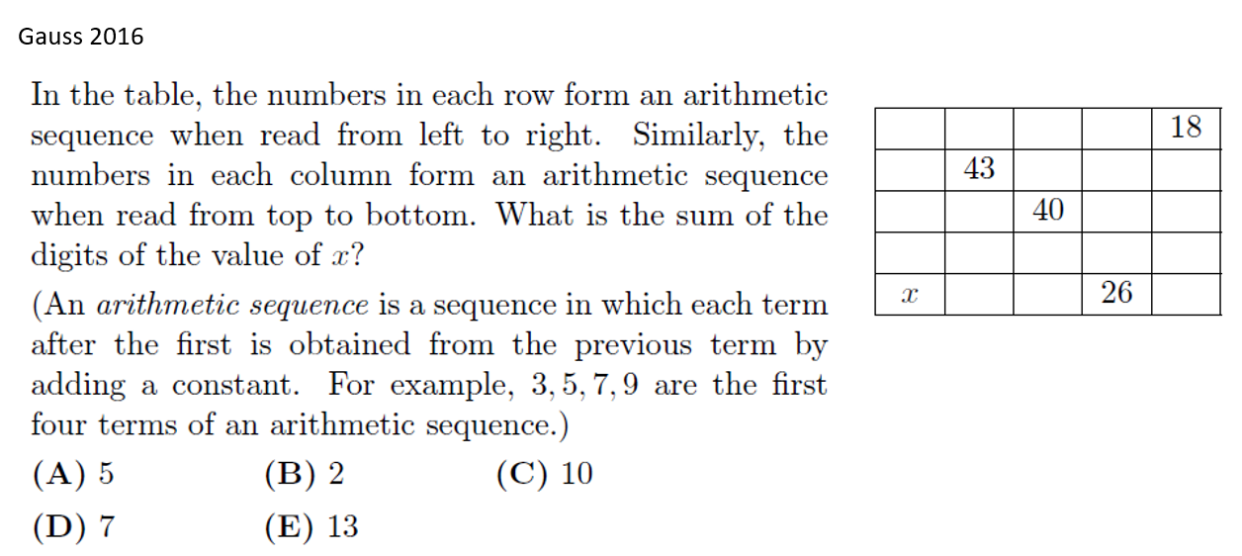

Slide 3
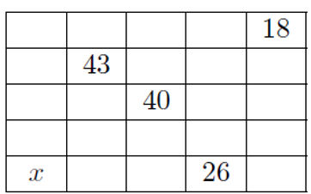
Assign letters for each column and row as the common difference of each arithmetic sequence
A
B
C
D
Use these spots to get an equation between any two variable!
E
F
G
H
I

Slide 4
A
B
C
D
E
F
G
H
I

Slide 5
So you now have two equations with only TWO variables! You just need the value of ONE variable to solve the rest of all the other variables!!!

Slide 6
A
B
C
D
E
F
G
H
I
The sum of the digits will then be 2

